Slide 1

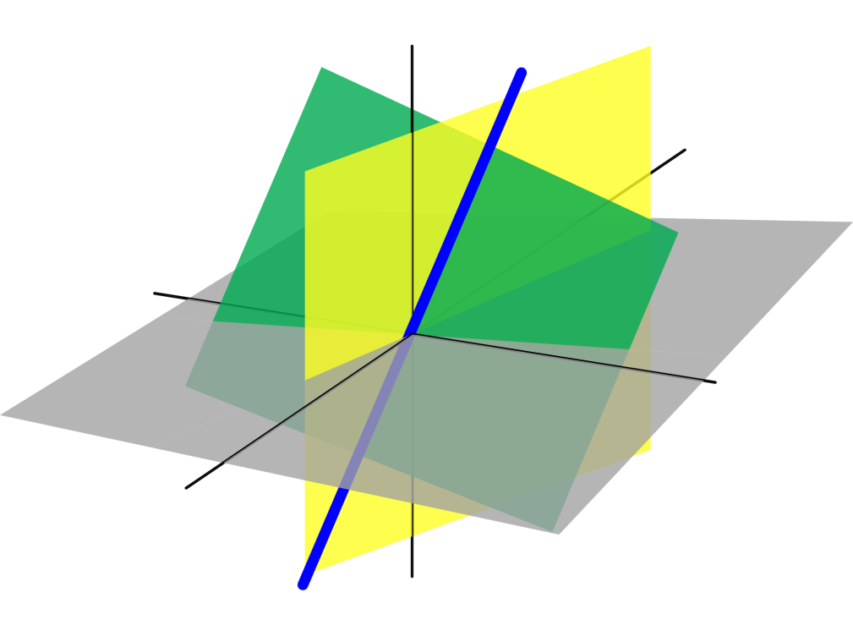
Azərbaycan Dövlət Neft və Sənaye Universiteti
Linear Algebra

Slide 2
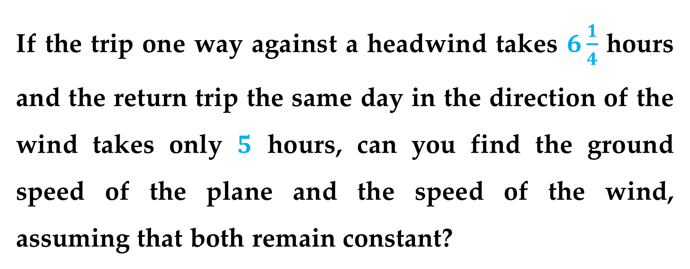
The most fundamental theme of linear algebra is the theory of systems of linear equations.
For example, suppose you travel on an airplane between two cities that are 5000 kilometers apart.
If the trip one way against a headwind takes $6\frac{1}{4}$ hours and the return trip the same day in the direction of the wind takes only $5$ hours, can you find the ground speed of the plane and the speed of the wind, assuming that both remain constant?
What is Linear Algebra?

Slide 3
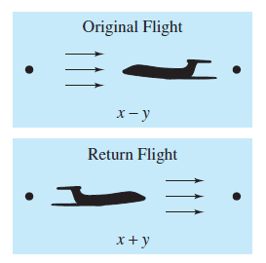
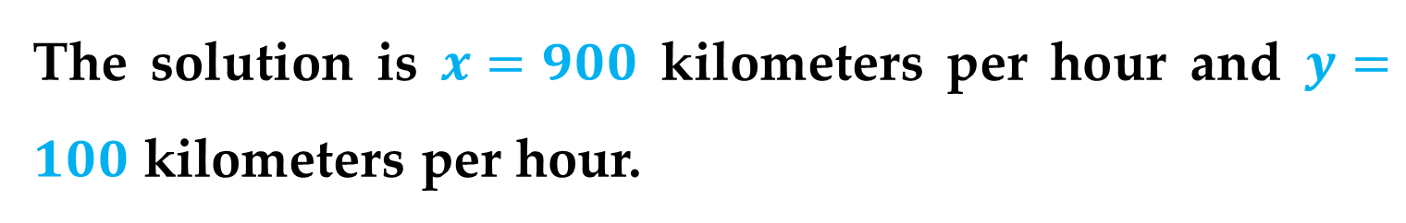


If you let x represent the speed of the plane and y the speed of the wind, then the following system models the problem:
$$6.25\left(x−y\right)=5000$$
$$5\left(x+y\right)=5000$$
$$x−y =800$$
$$x+y =1000$$
The solution is $x=900$ kilometers per hour and $y=100$ kilometers per hour.
What is Linear Algebra?

Slide 4
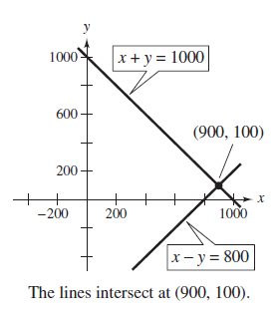
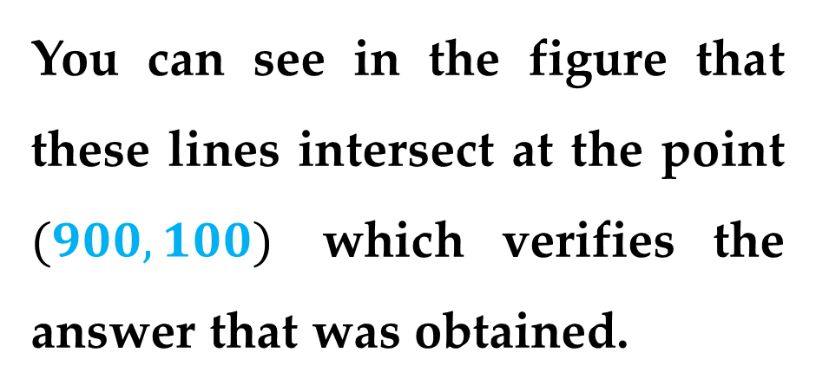
Geometrically, this system represents two lines in the xy-plane.
You can see in the figure that these lines intersect at the point $(900,100)$ which verifies the answer that was obtained.
What is Linear Algebra?

Slide 5
Solving systems of linear equations is one of the most important applications of linear algebra.
Linear applications arise in such diverse areas as
engineering
chemistry
economics
business
ecology
biology
psychology
etc.
What is Linear Algebra?

Slide 6
In real-world situations, it is not unusual to have to solve systems of hundreds or even thousands of equations.
One of the utmost goals of this course is to develop an algorithm that helps solve larger systems in an orderly manner and is amenable to computer implementation.
What is Linear Algebra?

Slide 7
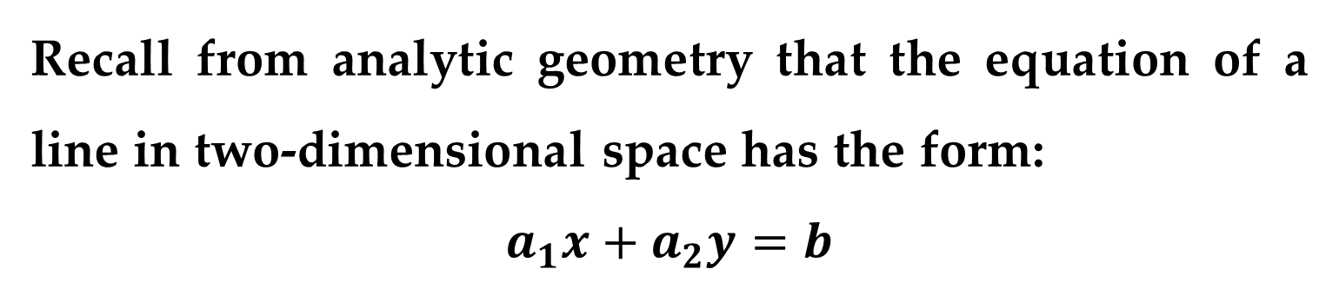
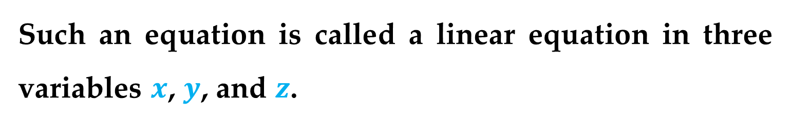
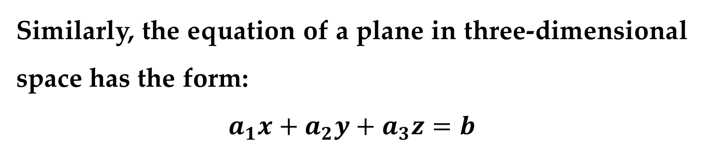
Recall from analytic geometry that the equation of a line in two-dimensional space has the form:
$$a_{1}x+a_{2}y=b$$
This is a linear equation in two variables $x$ and $y$.
Similarly, the equation of a plane in three-dimensional space has the form:
$$a_{1}x+a_{2}y+a_{3}z=b$$
Such an equation is called a linear equation in three variables $x$, $y$, and $z$.
Linear Equations in n variables

Slide 8
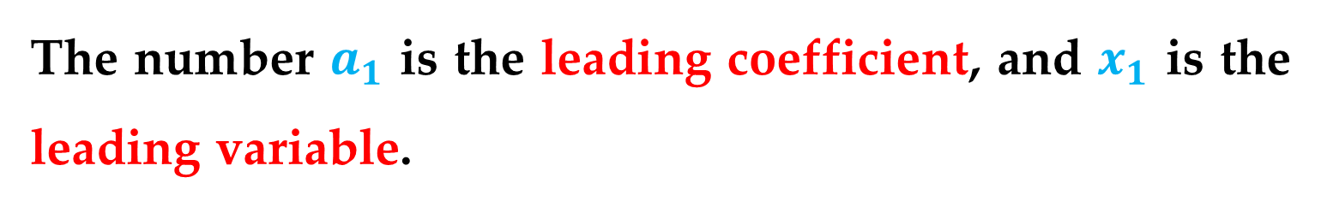
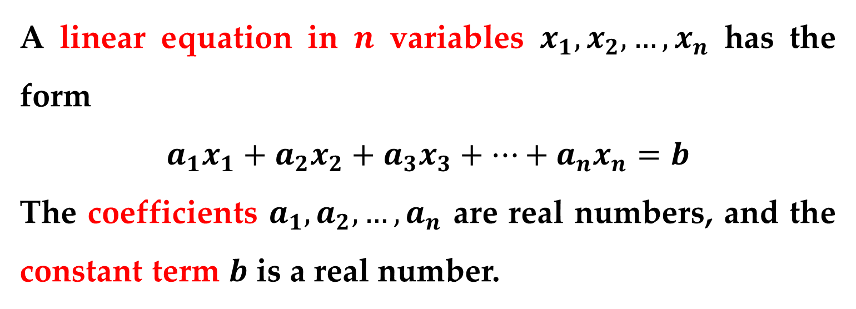
Definition of a Linear Equation in n Variables
A linear equation in $n$ variables $x_{1},x_{2},…,x_{n}$ has the form
$$a_{1}x_{1}+a_{2}x_{2}+a_{3}x_{3}+…+a_{n}x_{n}=b$$
The coefficients $a_{1},a_{2},…,a_{n}$ are real numbers, and the constant term $b$ is a real number.
The number $a_{1}$ is the leading coefficient, and $x_{1}$ is the leading variable.
Linear Equations in n variables

Slide 9
Remark
Linear equations have no products or roots of variables and no variables involved in trigonometric, exponential, or logarithmic functions.
Variables appear only to the first power.
Linear Equations in n variables

Slide 10
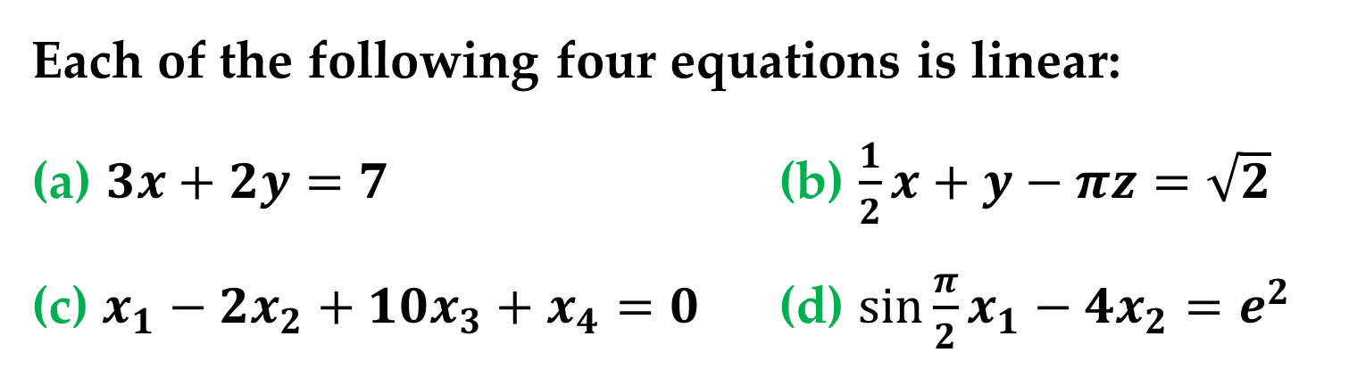
Example 1. Examples of Linear Equations and Nonlinear Equations
Each of the following four equations is linear:
(a) $3x+2y=7$ (b) $\frac{1}{2}x+y−πz=\sqrt{2}$
(c) $x_{1}−2x_{2}+10x_{3}+x_{4}=0$ (d) $\sin{\frac{π}{2}}x_{1}−4x_{2}=e^{2}$
Linear Equations in n variables

Slide 11
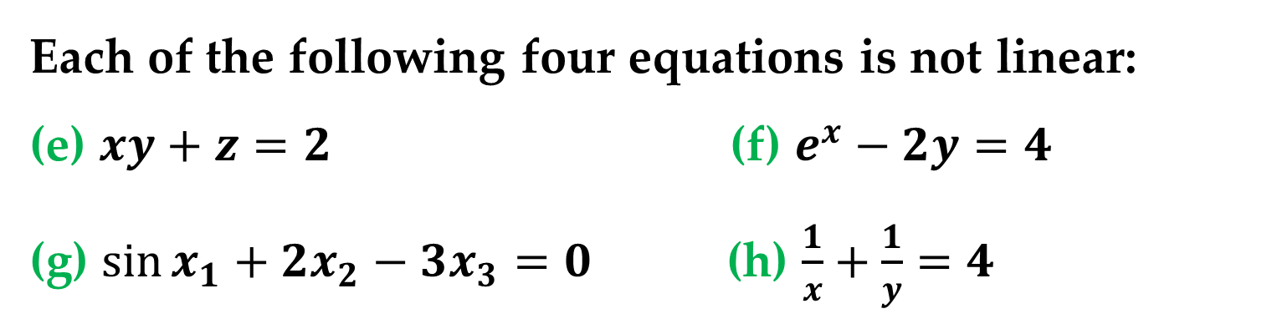
Example 1. Examples of Linear Equations and Nonlinear Equations
Each of the following four equations is not linear:
(e) $xy+z=2$ (f) $e^{x}−2y=4$
(g) $\sin{x_{1}}+2x_{2}−3x_{3}=0$ (h) $\frac{1}{x}+\frac{1}{y}=4$
Linear Equations in n variables

Slide 12
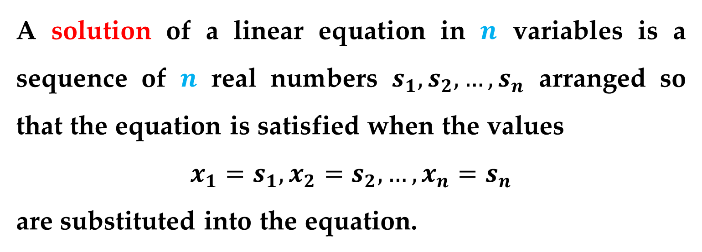
Definition
A solution of a linear equation in $n$ variables is a sequence of $n$ real numbers $s_{1},s_{2},…,s_{n}$ arranged so that the equation is satisfied when the values
$$x_{1}=s_{1},x_{2}=s_{2},…,x_{n}=s_{n}$$
are substituted into the equation.
Linear Equations in n variables

Slide 13
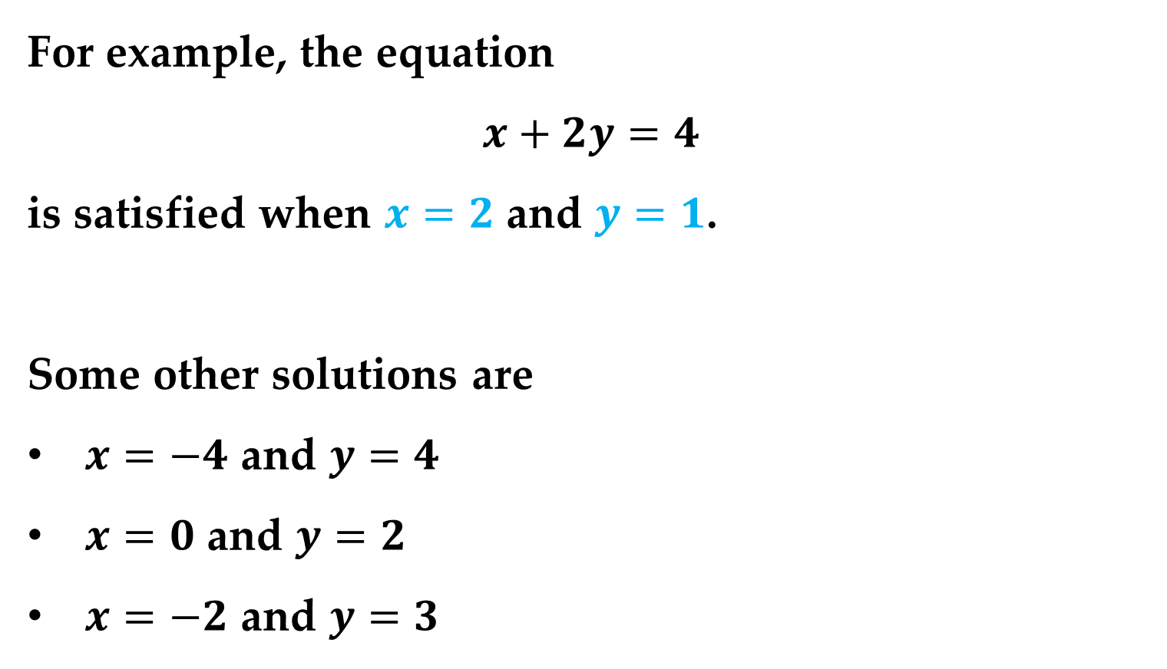
Example
For example, the equation
$$x+2y=4$$
is satisfied when $x=2$ and $y=1$.
Some other solutions are
$x=−4$ and $y=4$
$x=0$ and $y=2$
$x=−2$ and $y=3$
Linear Equations in n variables

Slide 14
Definition
The set of all solutions of a linear equation is called its solution set, and when this set is found, the equation is said to have been solved.
To describe the entire solution set of a linear equation, a parametric representation is often used.
Linear Equations in n variables

Slide 15
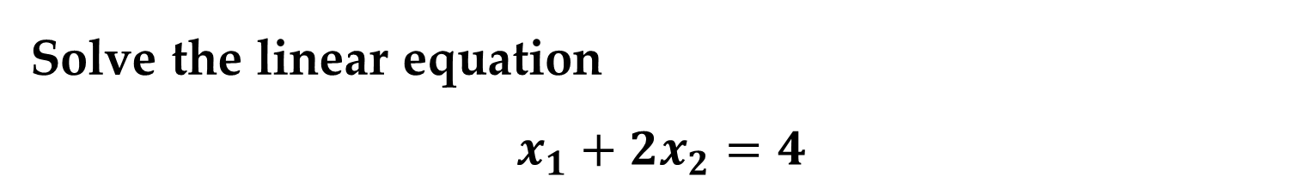
Example 2. Parametric Representation of a Solution Set
Solve the linear equation
$$x_{1}+2x_{2}=4$$
Solution
To find the solution set of an equation involving two variables, we need to solve for one of the variables in terms of the other variable.
Linear Equations in n variables

Slide 16
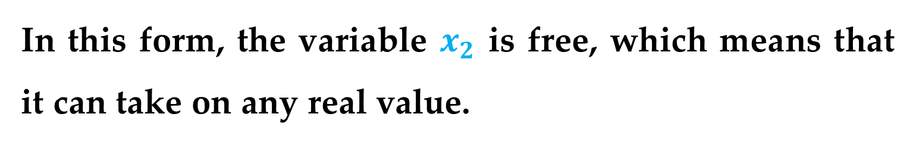
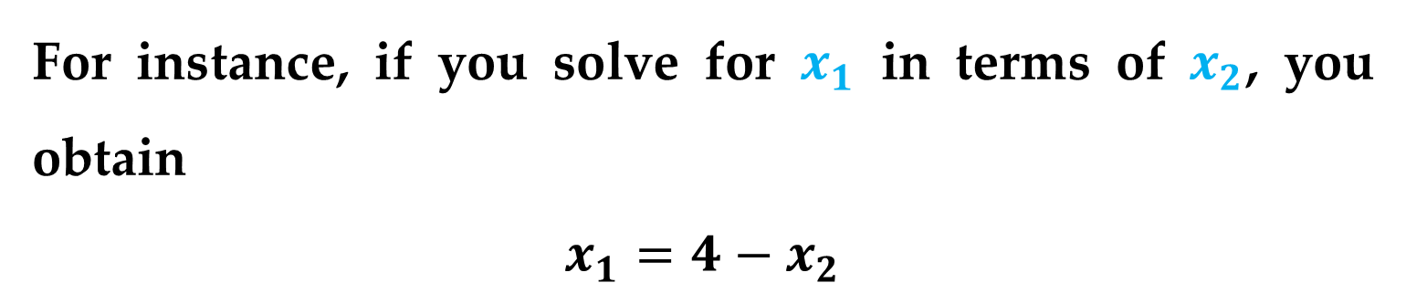
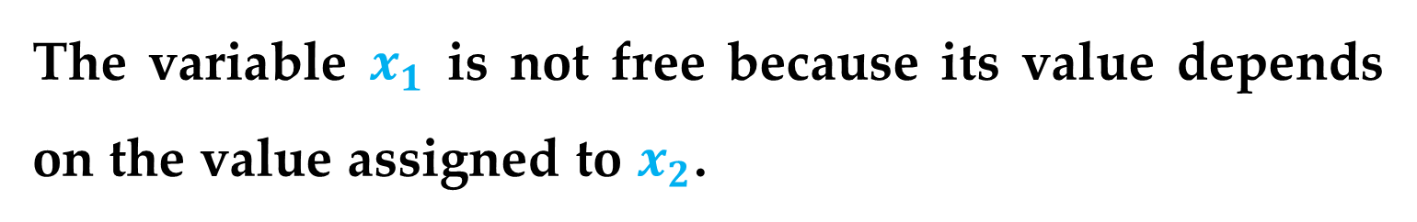
Solution (continued)
For instance, if you solve for $x_{1}$ in terms of $x_{2}$, you obtain
$$x_{1}=4−x_{2}$$
In this form, the variable $x_{2}$ is free, which means that it can take on any real value.
The variable $x_{1}$ is not free because its value depends on the value assigned to $x_{2}$.
Linear Equations in n variables

Slide 17
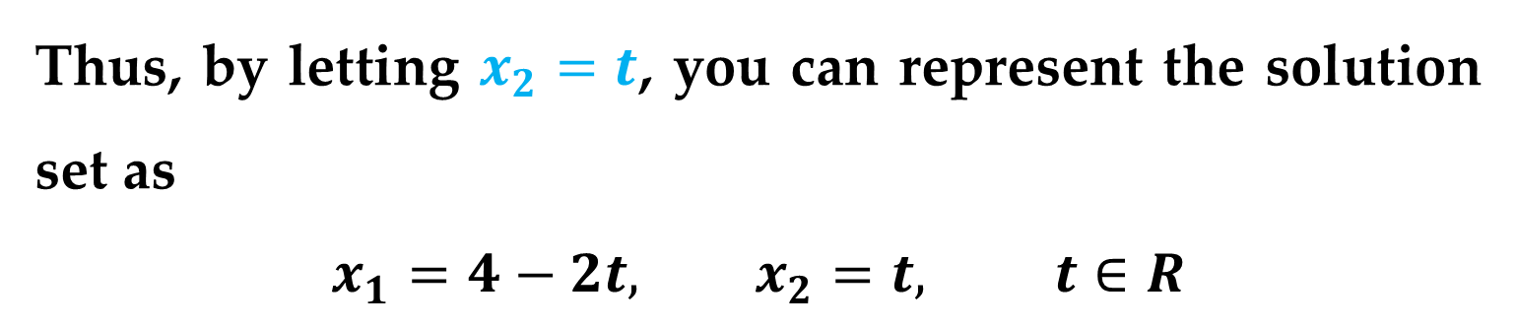
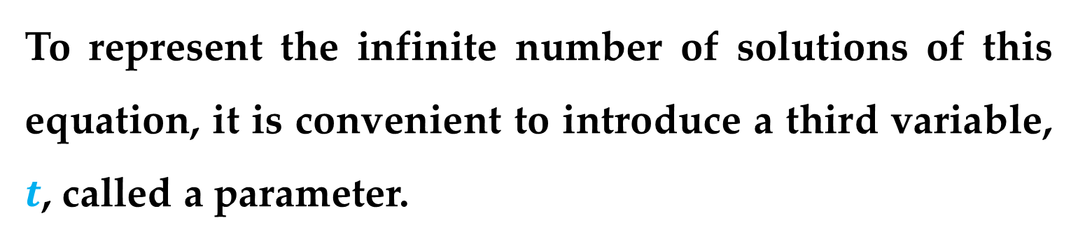
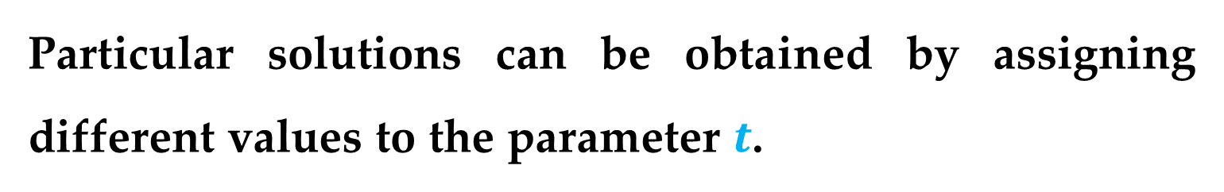
Solution (continued)
To represent the infinite number of solutions of this equation, it is convenient to introduce a third variable, $t$, called a parameter.
Thus, by letting $x_{2}=t$, you can represent the solution set as
$$x_{1}=4−2t, x_{2}=t, t∈R$$
Particular solutions can be obtained by assigning different values to the parameter $t$.
Linear Equations in n variables

Slide 18
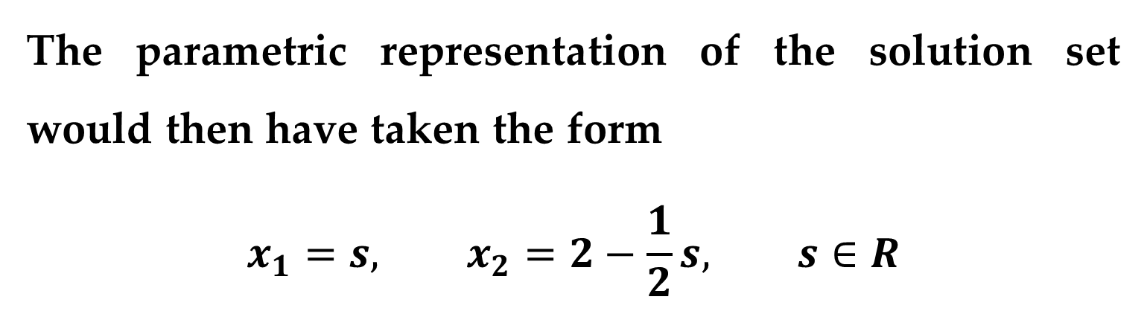
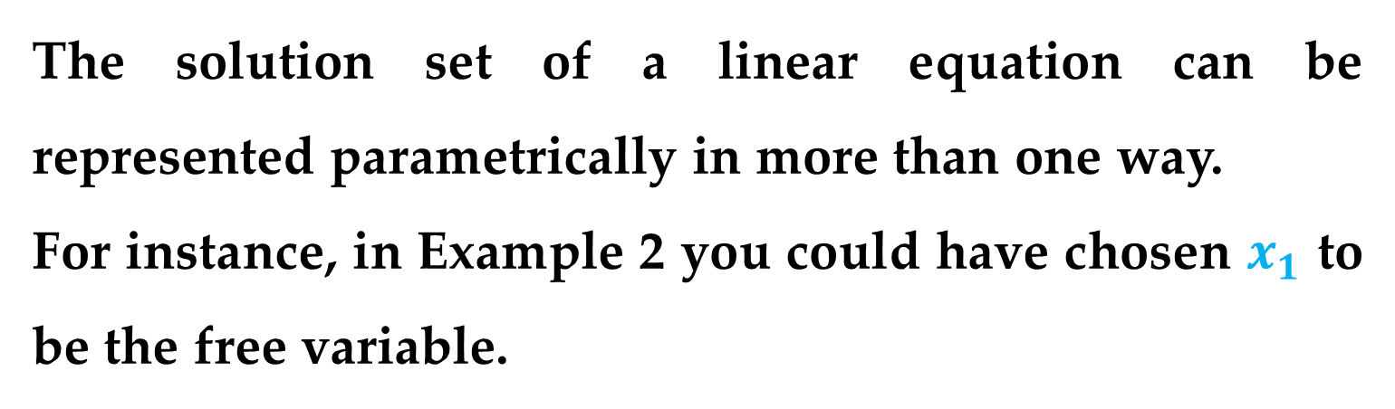
The solution set of a linear equation can be represented parametrically in more than one way.
For instance, in Example 2 you could have chosen $x_{1}$ to be the free variable.
The parametric representation of the solution set would then have taken the form
$$x_{1}=s, x_{2}=2−\frac{1}{2}s, s∈R$$
Linear Equations in n variables

Slide 19
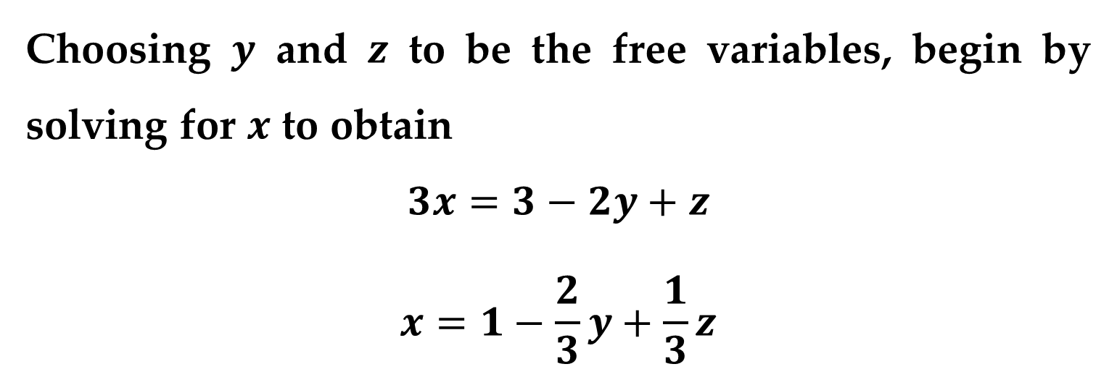
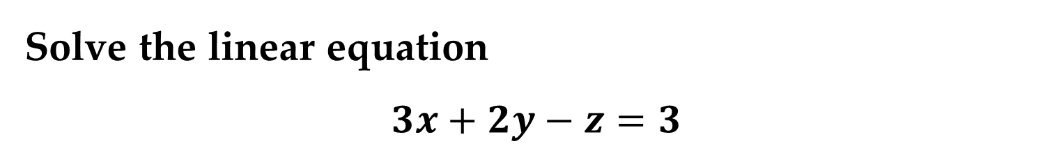
Example 3. Parametric Representation of a Solution Set
Solve the linear equation
$$3x+2y−z=3$$
Solution
Choosing $y$ and $z$ to be the free variables, begin by solving for $x$ to obtain
$$3x=3−2y+z$$
$$x=1−\frac{2}{3}y+\frac{1}{3}z$$
Linear Equations in n variables

Slide 20
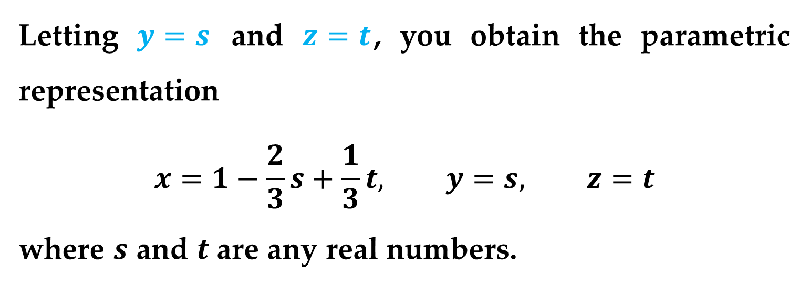
Solution (continued)
Letting $y=s$ and $z=t$, you obtain the parametric representation
$$x=1−\frac{2}{3}s+\frac{1}{3}t, y=s, z=t$$
where $s$ and $t$ are any real numbers.
Linear Equations in n variables

Slide 21
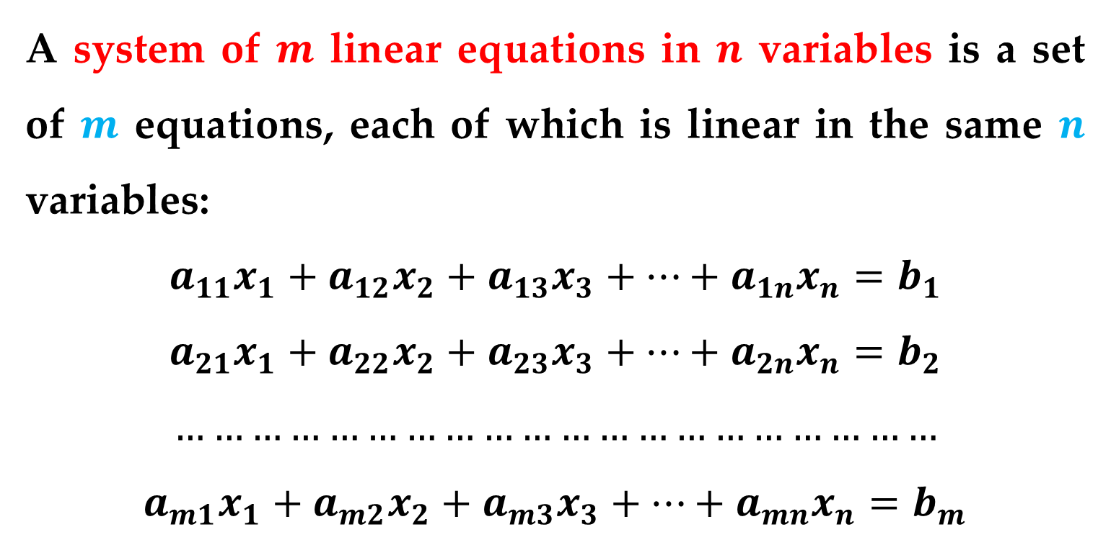
Definition
A system of $m$ linear equations in $n$ variables is a set of $m$ equations, each of which is linear in the same $n$ variables:
$$a_{11}x_{1}+a_{12}x_{2}+a_{13}x_{3}+…+a_{1n}x_{n}=b_{1}$$
$$a_{21}x_{1}+a_{22}x_{2}+a_{23}x_{3}+…+a_{2n}x_{n}=b_{2}$$
$$……………………………………………………$$
$$a_{m1}x_{1}+a_{m2}x_{2}+a_{m3}x_{3}+…+a_{mn}x_{n}=b_{m}$$
Systems of Linear Equations

Slide 22
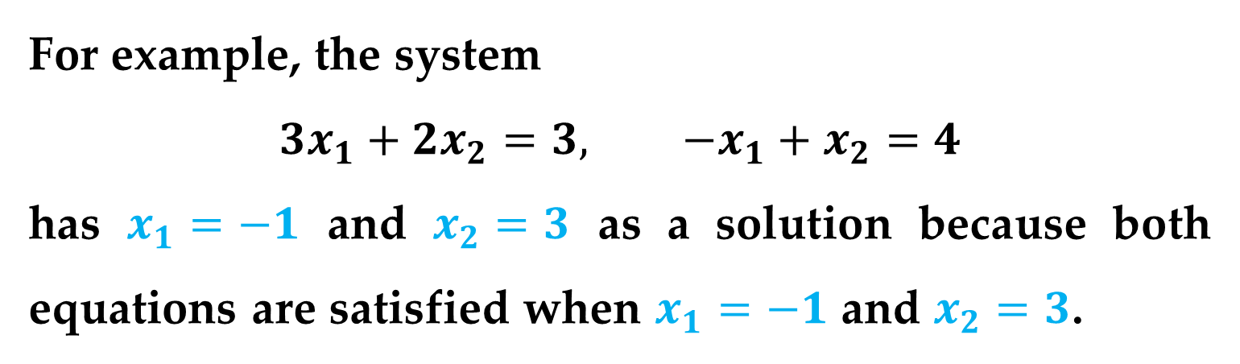
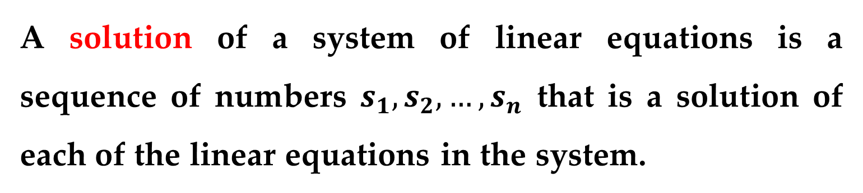
Definition
A solution of a system of linear equations is a sequence of numbers $s_{1},s_{2},…,s_{n}$ that is a solution of each of the linear equations in the system.
Example
For example, the system
$$3x_{1}+2x_{2}=3, −x_{1}+x_{2}=4$$
has $x_{1}=−1$ and $x_{2}=3$ as a solution because both equations are satisfied when $x_{1}=−1$ and $x_{2}=3$.
Systems of Linear Equations

Slide 23
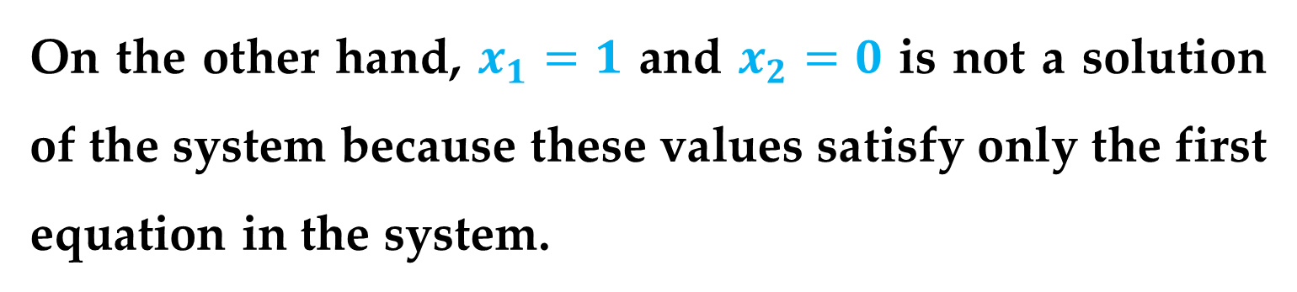
Example (continued)
On the other hand, $x_{1}=1$ and $x_{2}=0$ is not a solution of the system because these values satisfy only the first equation in the system.
Systems of Linear Equations

Slide 24
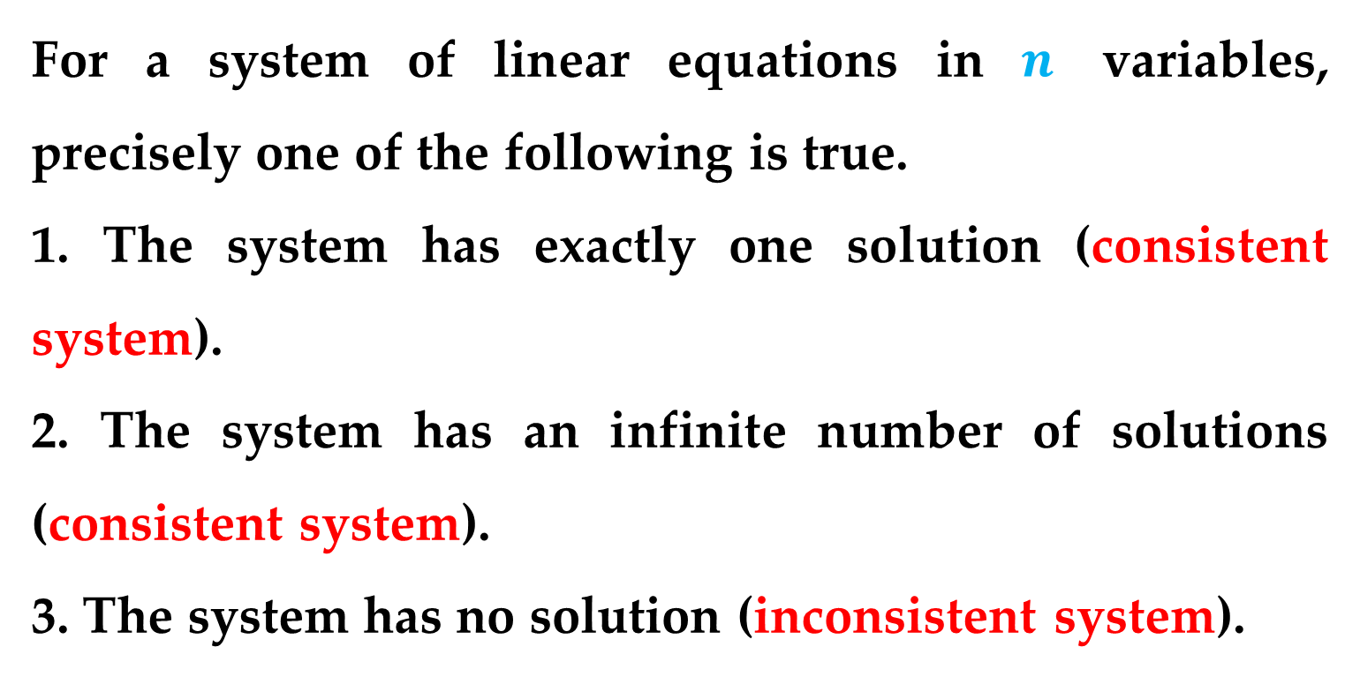
Number of Solutions of a System of Linear Equations
For a system of linear equations in $n$ variables, precisely one of the following is true.
1. The system has exactly one solution (consistent system).
2. The system has an infinite number of solutions (consistent system).
3. The system has no solution (inconsistent system).
Systems of Linear Equations

Slide 25
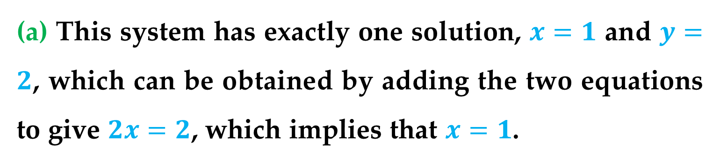
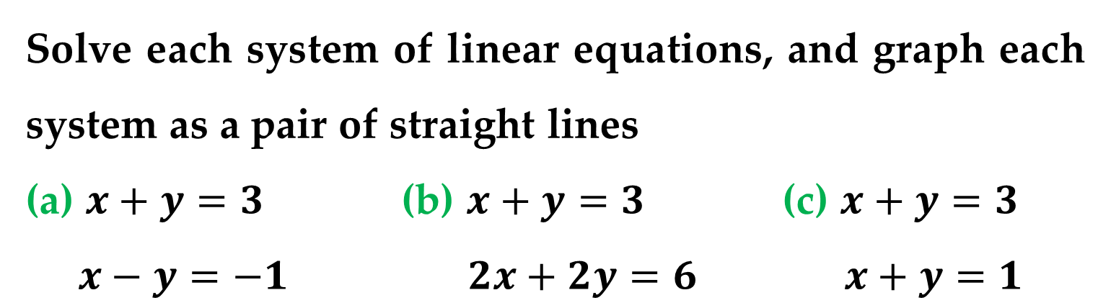
Example 4. Systems of Two Equations in Two Variables
Solve each system of linear equations, and graph each system as a pair of straight lines
(a) $x+y=3$ (b) $x+y=3$ (c) $x+y=3$
$x−y=−1$ $2x+2y=6$ $x+y=1$
Solution
(a) This system has exactly one solution, $x=1$ and $y=2$, which can be obtained by adding the two equations to give $2x=2$, which implies that $x=1$.
Systems of Linear Equations

Slide 26
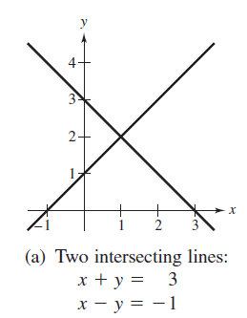
Solution (continued)
The graph of this system is represented by two intersecting lines, as shown in the following Figure:
Systems of Linear Equations

Slide 27
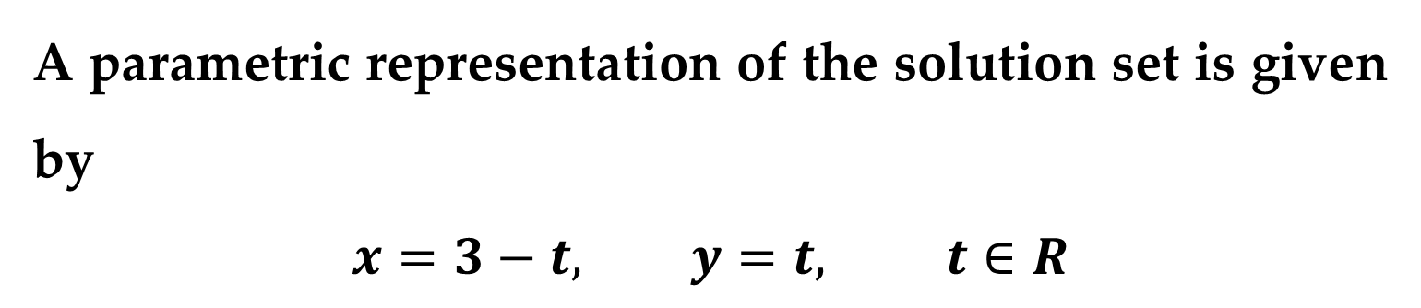
Solution (continued)
(b) This system has an infinite number of solutions because the second equation is the result of multiplying both sides of the first equation by 2.
A parametric representation of the solution set is given by
$$x=3−t, y=t, t∈R$$
Systems of Linear Equations

Slide 28
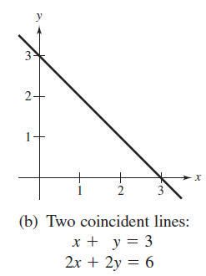
Solution (continued)
The graph of this system is represented by two coincident lines, as shown in the following Figure:
Systems of Linear Equations

Slide 29
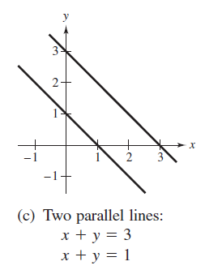
Solution (continued)
(c) This system has no solution because it is impossible for the sum of two numbers to be 3 and 1 simultaneously.
The graph of this system is represented by two parallel lines, as shown in the following Figure:
Systems of Linear Equations

Slide 30
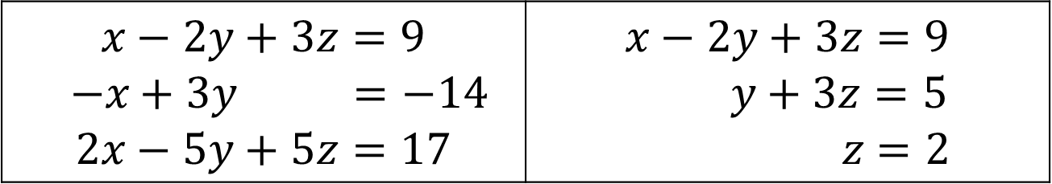
Which system is easier to solve algebraically?
$$x−2y+3z=9$$ $$−x+3y =−14$$ $$2x−5y+5z=17$$ | $$x−2y+3z=9$$ $$y+3z=5$$ $$z=2$$
The system on the right is clearly easier to solve, because it is in row-echelon form, which means that it follows a stair-step pattern and has leading coefficients of 1.
To solve such a system, use a procedure called back-substitution.
Solving a System of Linear Equations

Slide 31
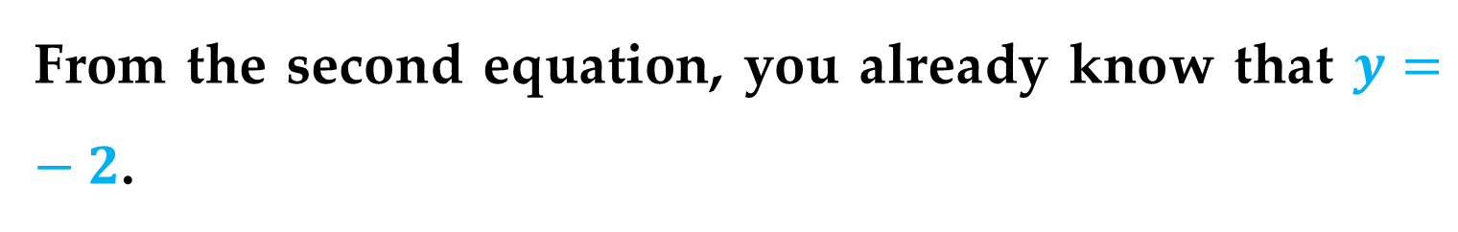
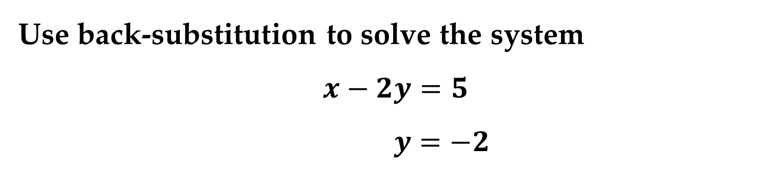
Example 5. Using Back-Substitution to Solve a System in Row-Echelon Form
Use back-substitution to solve the system
$$x−2y=5$$
$$y=−2$$
Solution
From the second equation, you already know that $y=−2$.
Solving a System of Linear Equations

Slide 32

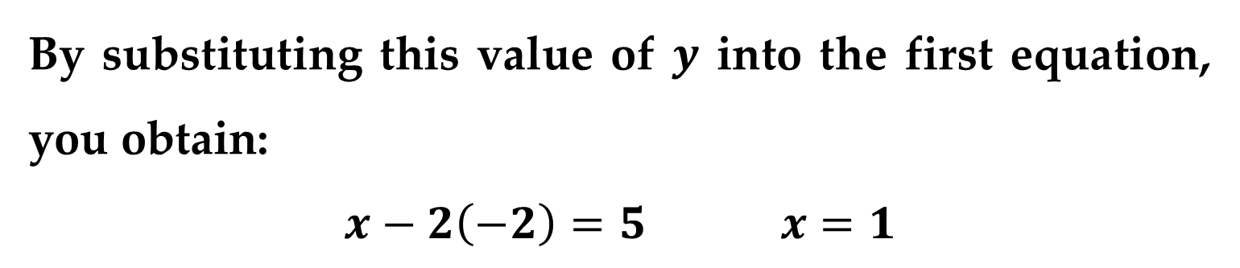
Solution (continued)
By substituting this value of $y$ into the first equation, you obtain:
$$x−2\left(−2\right)=5 x=1$$
Thus the system has exactly one solution:
$$x=1, y=−2$$
Solving a System of Linear Equations

Slide 33
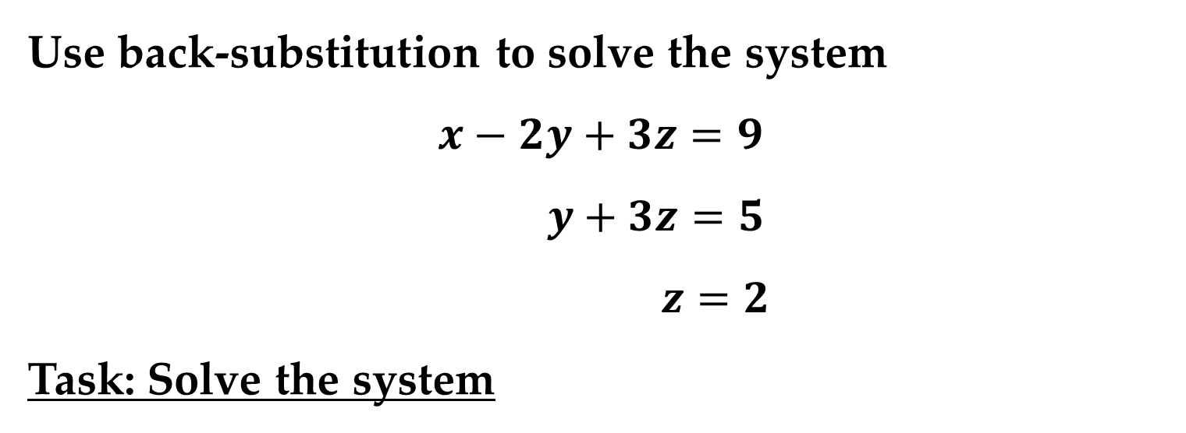
Example 6. Using Back-Substitution to Solve a System in Row-Echelon Form
Use back-substitution to solve the system
$$x−2y+3z=9$$
$$y+3z=5$$
$$z=2$$
Task: Solve the system
Solving a System of Linear Equations

Slide 34
Definition
Two systems of linear equations are called equivalent if they have precisely the same solution set.
To solve a system that is not in row-echelon form, first change it to an equivalent system that is in row-echelon form by using the operations listed below.
Solving a System of Linear Equations

Slide 35
Operations That Lead to Equivalent Systems of Equations
1. Interchange two equations
2. Multiply an equation by a nonzero constant
3. Add a multiple of an equation to another equation
Rewriting a system of linear equations in row-echelon form usually involves a chain of equivalent systems, each of which is obtained by using one of the three basic operations.
Solving a System of Linear Equations

Slide 36
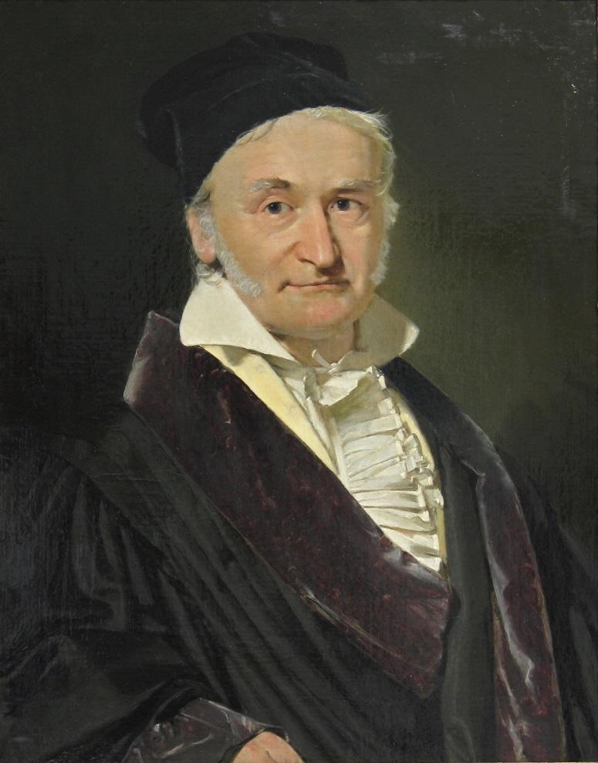
This process is called Gaussian elimination, after the German mathematician Carl Friedrich Gauss (1777–1855).
Solving a System of Linear Equations

Slide 37
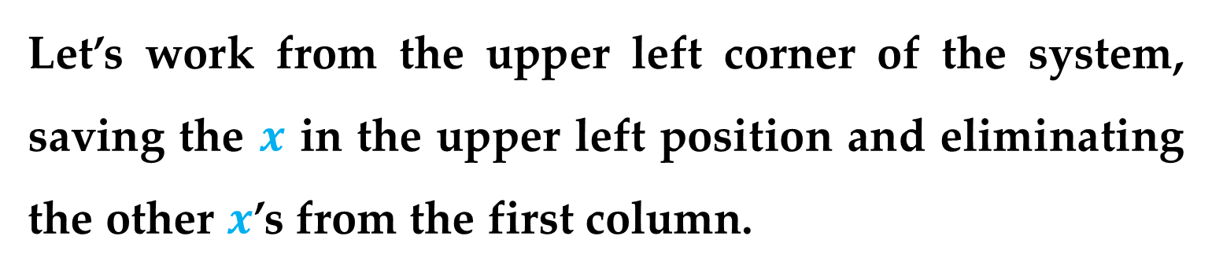
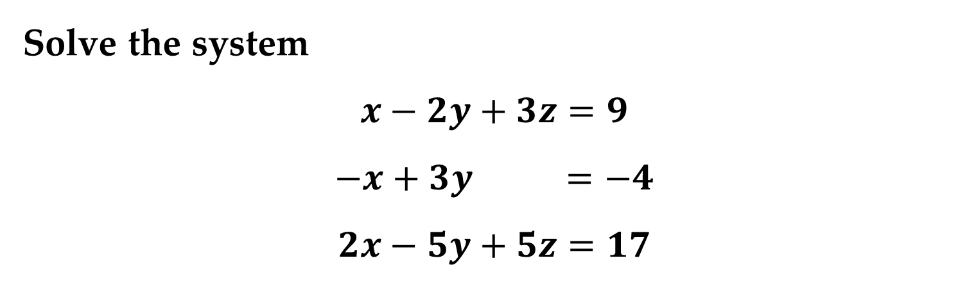
Example 7. Using Elimination to Rewrite a System in Row-Echelon Form
Solve the system
$$x−2y+3z=9$$
$$−x+3y =−4$$
$$2x−5y+5z=17$$
Solution
Let’s work from the upper left corner of the system, saving the $x$ in the upper left position and eliminating the other $x$’s from the first column.
Solving a System of Linear Equations

Slide 38
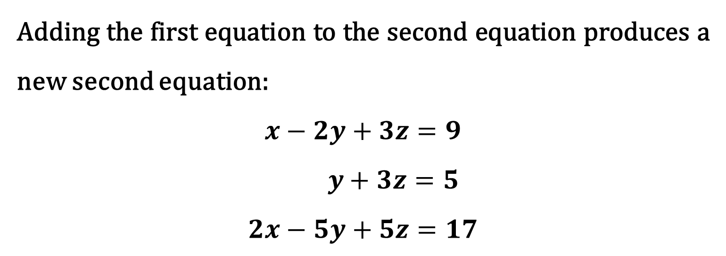
Solution (continued)
Adding the first equation to the second equation produces a new second equation:
$$x−2y+3z=9$$
$$y+3z=5$$
$$2x−5y+5z=17$$
Solving a System of Linear Equations

Slide 39
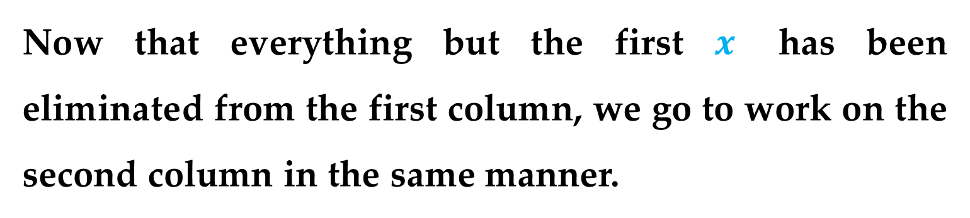
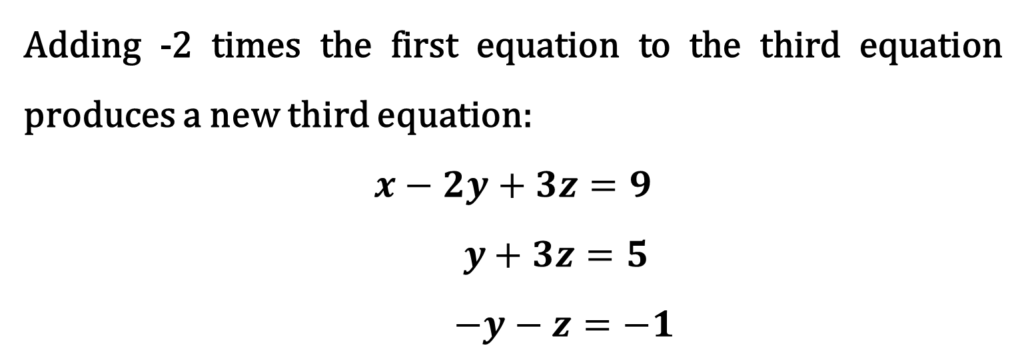
Solution (continued)
Adding -2 times the first equation to the third equation produces a new third equation:
$$x−2y+3z=9$$
$$y+3z=5$$
$$−y−z=−1$$
Now that everything but the first $x$ has been eliminated from the first column, we go to work on the second column in the same manner.
Solving a System of Linear Equations

Slide 40
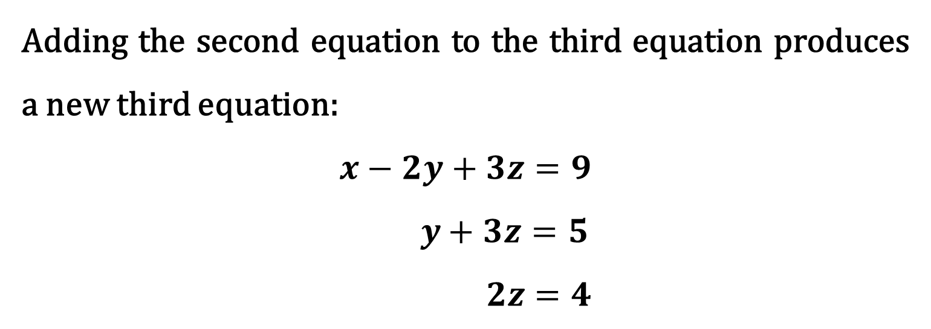
Solution (continued)
Adding the second equation to the third equation produces a new third equation:
$$x−2y+3z=9$$
$$y+3z=5$$
$$2z=4$$
Solving a System of Linear Equations

Slide 41


Solution (continued)
Multiplying the third equation by 1/2 produces a new third equation:
$$x−2y+3z=9$$
$$y+3z=5$$
$$z=2$$
This is the same system of equations that we solved in Example 6, and, as in that example, the solution is known
$$x=1, y=−1, z=2$$
Solving a System of Linear Equations

Slide 42

Each of the three equations in this Example is represented in a three-dimensional coordinate system by a plane.
Because the unique solution of the system is the point $\left(x,y,z\right)=(1,−1,2)$, the three planes intersect at the point represented by these coordinates, as shown in the following Figure.
Solving a System of Linear Equations

Slide 43

Solving a System of Linear Equations

Slide 44
Because many steps are required to solve a system of linear equations, it is very easy to make errors in arithmetic.
Hence it is suggested that you develop the habit of checking your solution by substituting it into each equation of the original system.
Solving a System of Linear Equations

Slide 45

For instance, in Example 7, you can check the solution
$$x=1, y=−1, z=2$$
as follows:
$$Equation 1: \left(1\right)−2\left(−1\right)+3\left(2\right)=9$$
$$Equation 2: −\left(1\right)+3\left(−1\right)=−4$$
$$Equation 3: 2\left(1\right)−5\left(−1\right)+5\left(2\right)=17$$
Solving a System of Linear Equations

Slide 46

Example 8. An Inconsistent System
Solve the system:
$$x_{1}−3x_{2}+x_{3}=1$$
$$2x_{1}−x_{2}−2x_{3}=2$$
$$x_{1}+2x_{2}−3x_{3}=−1$$
Solving a System of Linear Equations

Slide 47

Solution
Adding -2 times the first equation to the second equation produces a new second equation:
$$x_{1}−3x_{2}+x_{3}=1$$
$$5x_{2}−4x_{3}=0$$
$$x_{1}+2x_{2}−3x_{3}=−1$$
Solving a System of Linear Equations

Slide 48

Solution (continued)
Adding -1 times the first equation to the third equation produces a new third equation:
$$x_{1}−3x_{2}+x_{3}=1$$
$$5x_{2}−4x_{3}=0$$
$$5x_{2}−4x_{3}=−2$$
Solving a System of Linear Equations

Slide 49

Solution (continued)
Now, continuing the elimination process, add -1 times the second equation to the third equation to produce a new third equation:
$$x_{1}−3x_{2}+x_{3}=1$$
$$5x_{2}−4x_{3}=0$$
$$0=−2$$
Solving a System of Linear Equations

Slide 50
Solution (conclusion)
Because the third “equation” is a false statement, this system has no solution.
Moreover, because this system is equivalent to the original system, we conclude that the original system also has no solution.
Solving a System of Linear Equations

Slide 51
As in the previous Example, the three equations in this Example represent planes in a three-dimensional coordinate system.
In this example, however, the system is inconsistent.
So, the planes do not have a point in common, as shown in the following Figure.
Solving a System of Linear Equations

Slide 52

Solving a System of Linear Equations

Slide 53

Example 9. A System with an Infinite Number of Solutions
Solve the system:
$$x_{2}−x_{3}=0$$
$$x_{1} −3x_{3}=−1$$
$$−x_{1}+3x_{2} =1$$
Solving a System of Linear Equations

Slide 54

Solution
The first two equations are interchanged:
$$x_{1} −3x_{3}=−1$$
$$x_{2}−x_{3}=0$$
$$−x_{1}+3x_{2} =−1$$
Solving a System of Linear Equations

Slide 55

Solution (continued)
Adding the first equation to the third equation produces a new third equation:
$$x_{1} −3x_{3}=−1$$
$$x_{2}−x_{3} =0$$
$$3x_{2}−3x_{3}=0$$
Solving a System of Linear Equations

Slide 56


Solution (continued)
Adding -3 times the second equation to the third equation produces a new third equation:
$$x_{1} −3x_{3}=−1$$
$$x_{2}−x_{3} =0$$
$$0=0$$
Because the third equation is unnecessary, we drop it:
$$x_{1} −3x_{3}=−1$$
$$x_{2}−x_{3} =0$$
Solving a System of Linear Equations

Slide 57


Solution (conclusion)
To represent the solution, choose $x_{3}$ to be the free variable and represent it by the parameter $t$.
Because $x_{2}=x_{3}$ and $x_{1}=3x_{3}−1$, you can describe the solution set as
$$x_{1}=3t−1, x_{2}=t, x_{3}=t, t∈R$$
Solving a System of Linear Equations

Slide 58

References
Linear Algebra and Its Applications, 4th Edition

Slide 59

References
Linear Algebra: A Modern Introduction

Slide 60

References
Introduction to Linear Algebra, Fourth Edition

Slide 61

References
Elementary Linear Algebra

Slide 62

References
College Mathematics for Business, Economics, Life Sciences, and Social Sciences (13th Edition)
Chapters 4, 5, 6

Slide 63

References
Schaum's Outline of Introduction to Mathematical Economics, 3rd Edition
Chapters 10,11,12

Slide 64
Thank You for Attention

